Slide 1
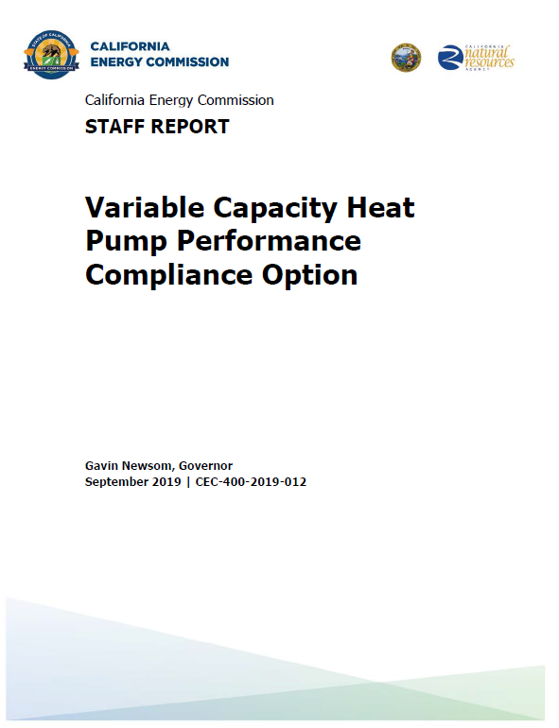
2019 T24 VCHP Performance Credit
Adapted from Matt Christie’s Presentation “How to Spot a Good Heat Pump”
Approved at
Nov. 13, 2019
Business Meeting
Notes:
Paste from report

Slide 2
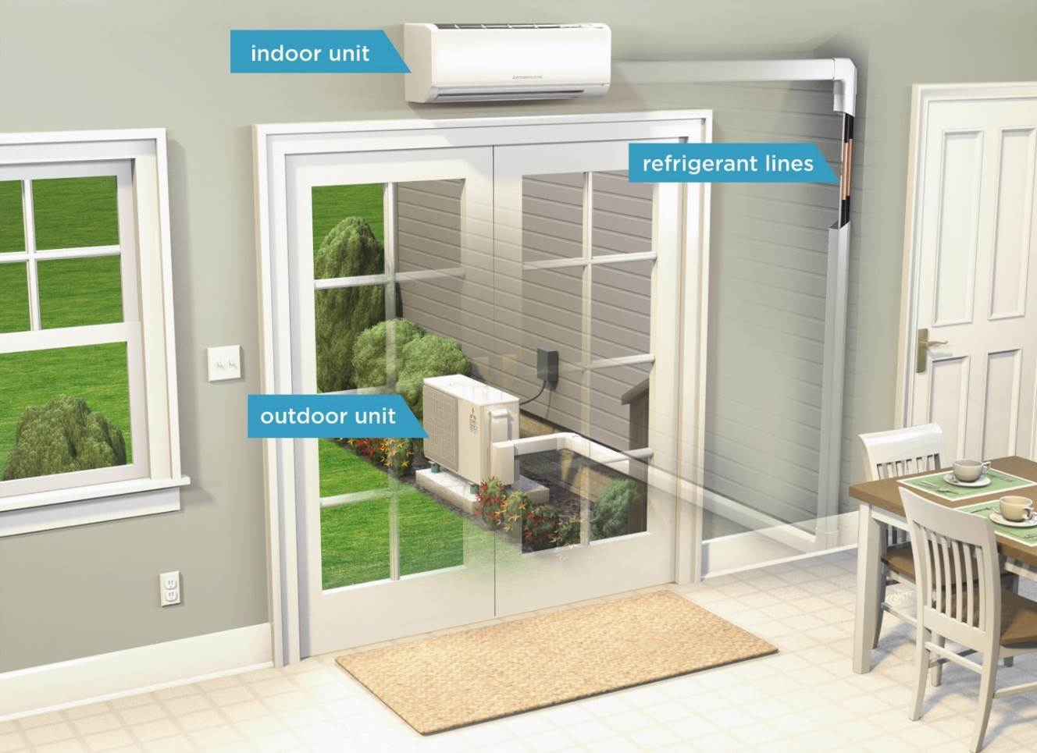
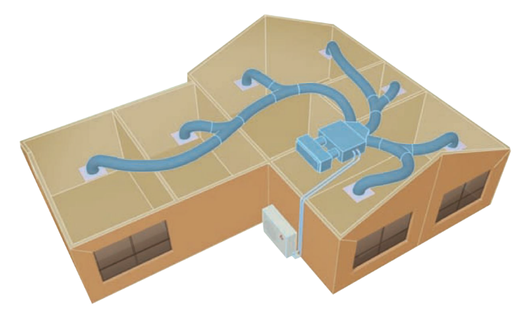
Equipment Type
5% cooling energy savings over minimum efficiency
12% heating energy savings over minimum efficiency
Mini and multi-split VCHP systems with ductless indoor units
Ducted mini and multi split VCHP systems CEC certified low-static indoor units
50W/ton continuous fan energy assumed for ducted VCHP systems unless manufacturer certifies the fan does not operate continuously in the factory default control configuration in which there is an additional compliance credit available

Slide 3
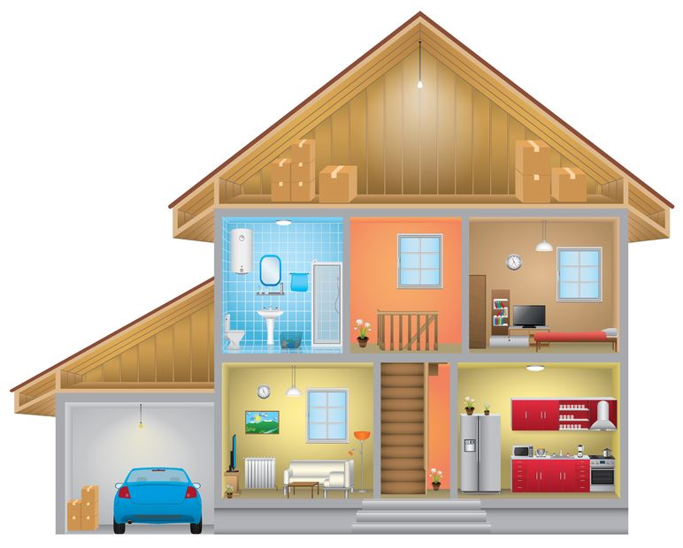
Installation
All ducts and indoor units (ducted or ductless) must be located entirely in conditioned space
Compliance credit for ducts in conditioned space
Wall mount thermostat required in each zone >150 ft²
Each habitable room must be directly served by ducted air handler or ductless head – Transfer fans do not meet this requirement
HABITABLE SPACE is space in a building for living, sleeping, eating or cooking, excluding bathrooms, toilets, hallways, storage areas, closets, utility rooms and similar areas.

Slide 4
Verification (HERS Rater)
HERS Field verification of installed system including:
Feature | Ductless | Ducted
Habitable room(s) supplied with conditioned air | Indoor unit | Supply air outlet
Zones >150 ft² | Wall mounted thermostat provided
Indoor Units | Located in conditioned space
Make/model/serial numbers must be visible for verification | Indoor & outdoor units | Including verification to CEC certified low-static VCHP listing for indoor units
Refrigerant | Refrigerant charge verified Per RA3.2 no matter the climate zone
System Airflow & Fan Efficacy per §150.0(m)13 | Not applicable | 350 cfm/ton of nominal cooling (300 cfm/ton for altered systems complying w/refrigerant charge) of indoor unit MERV 13 filter with a maximum clean filter pressure drop of 0.1 inch w.c. at the filter's design airflow rate, regardless of filter depth
Low Leakage Ducts in conditioned space | Not applicable | Required per RA3.1.4.3.8
Non-continuous fan operation “Extra Credit” for HERS verification for indoor+outdoor unit combinations | Not applicable | Manufacturer certifies to CEC and then HERS rater verifies that equipment installed meets requirements

