Slide 1
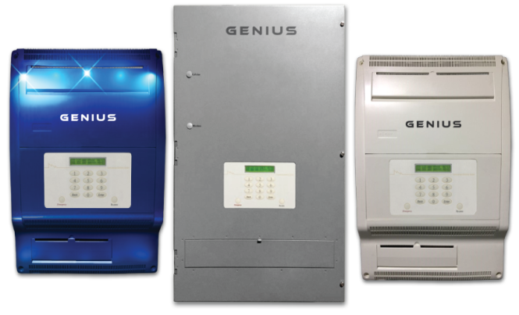
GENIUS Energy Hub - An innovative solid state electricity panel replaces the century-old breaker panel.
GENIUS provides the end user with a unified central electricity gateway.
Using advanced and reliable electrical switching and communication technology, GENIUS manages the entire electricity network and integrated resources down to each single circuit from a single point.
GENIUS is revenue grade approved by Weights and Measures USA and Measurement Canada.
The original smart panel!
15 Years of proven 100% uptime
Deployed in 7 countries
Easiest technology to install and use
Energy Hub
“This panel is unlike any other technology available to home owners.”
Vic@kobensystems.com
416-935-1922

Slide 2
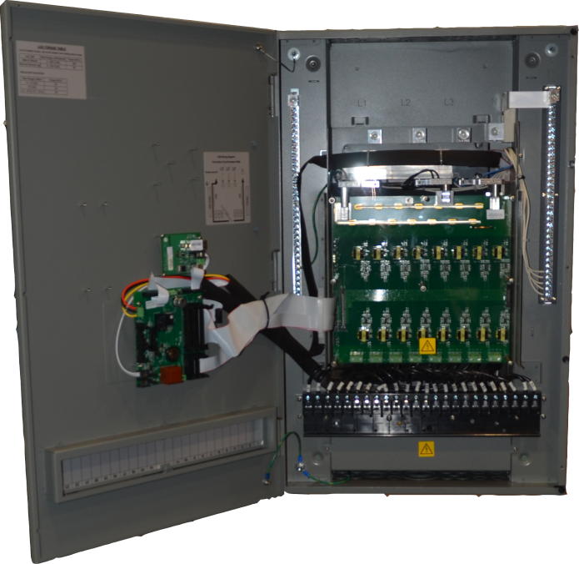
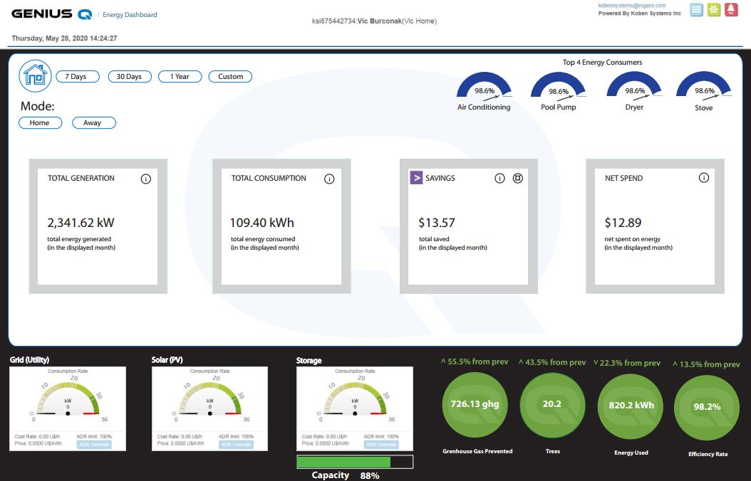
Solid State Technology
Unified Platform
“Not a mechanical panel “

Slide 3
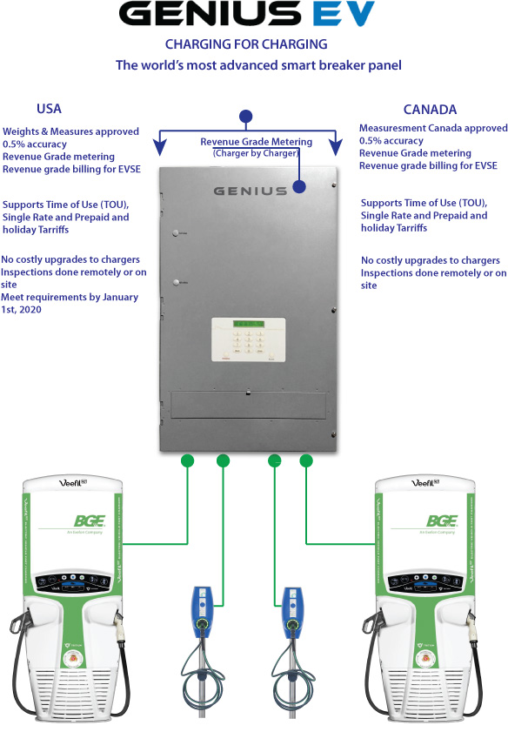
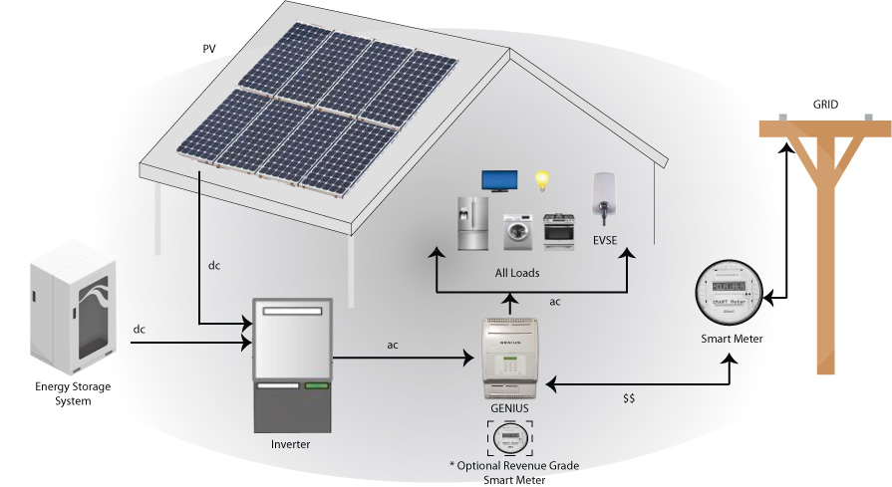
GENIUS Applications
Micro/Nano Grid Controller
“True” whole home back up for each load. Grid-tied or off-grid - for solar, storage, wind, generator, fuel cell and EV or any other energy source. Dynamic pricing by circuit and energy source. No essential load panels required.

